Slide 1


Slide 2
About Today…
Databases
Intro to database
PostgreSQL

Slide 3


Slide 4

Intro to Databases
Definition
A database is an organized collection of structured information or data,
typically stored electronically in a computer system
Purpose
To store, manage, and retrieve data efficiently

Slide 5
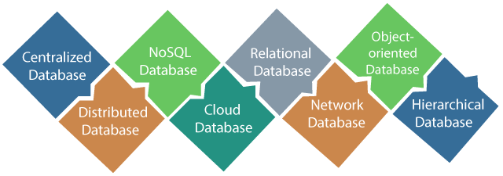
Types of Databases
Relational Databases
(e.g., PostgreSQL, MySQL, Oracle)
NoSQL Databases
NoSQL Databasess

Slide 6
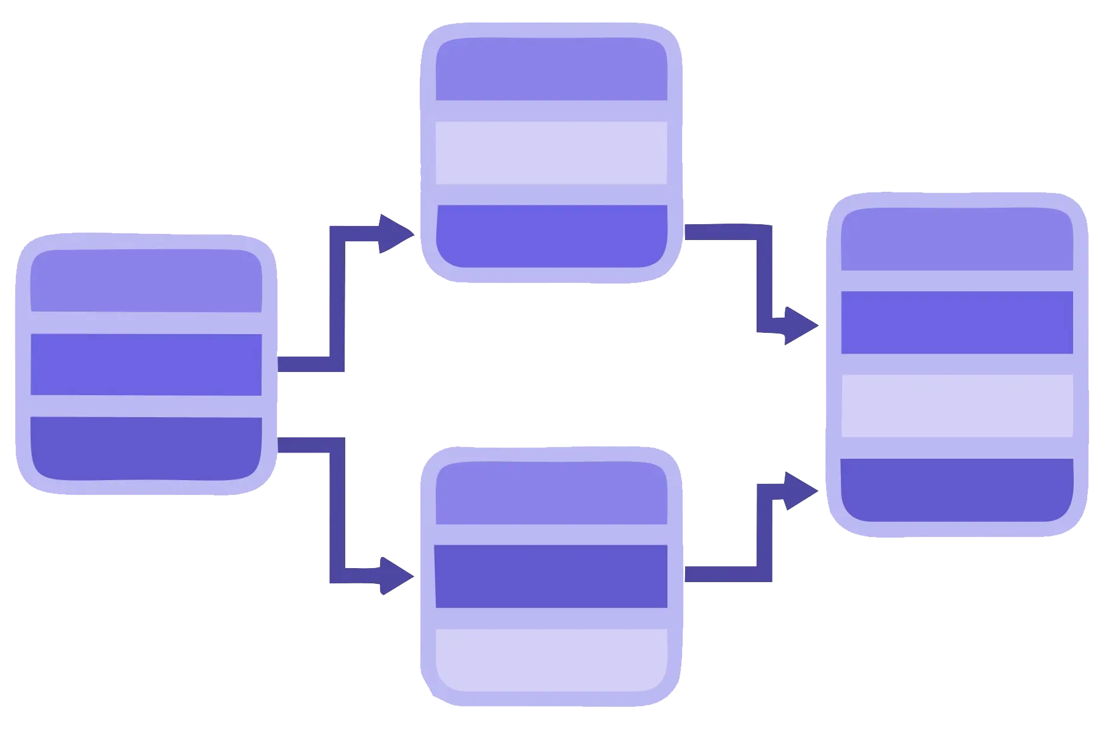
Relational Databases
Definition
A relational database organizes data into tables (relations) which can be linked by defined relationships
Characteristics
Tables, rows, columns, keys, relationships
Examples
PostgreSQL, MySQL, Oracle

Slide 7
Introduction to PostgreSQL
Open-source relational database
Developed by PostgreSQL Global Development Group
Known for its robustness, performance, and advanced features

Slide 8
Key Features of PostgreSQL
ACID Compliance
Ensures reliable transactions
Maintains data integrity
Advanced Data Types
Supports JSON, XML, hstore, and custom types
Extensibility
Custom functions, operators, and index types
Extensions like PostGIS for spatial data

Slide 9
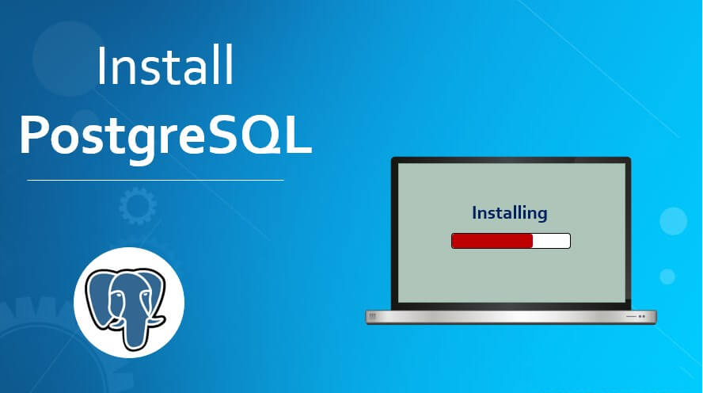

Slide 10
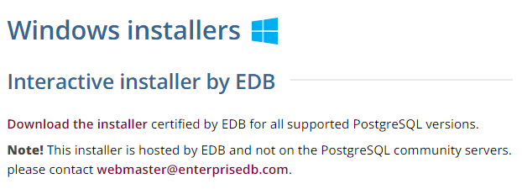
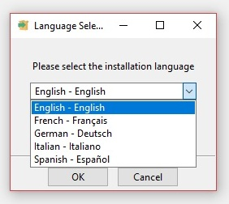
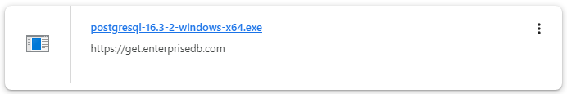
Installing PostgreSQL
Follow the URL :
https://www.postgresql.org/download/windows/

Slide 11
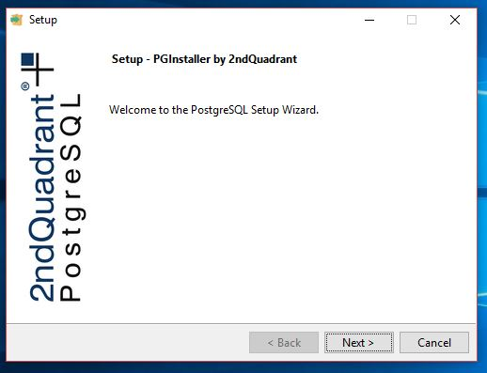
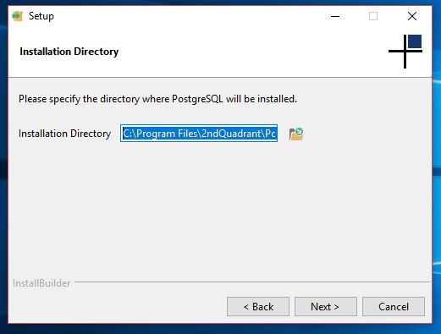
Installing PostgreSQL

Slide 12
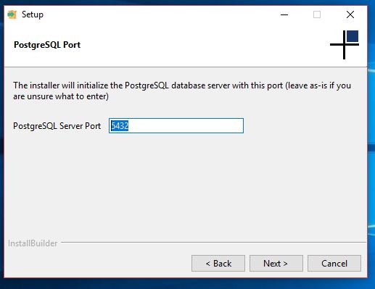
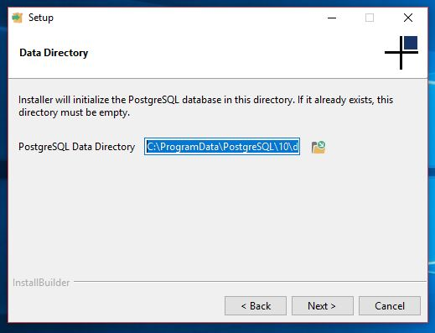
Installing PostgreSQL

Slide 13
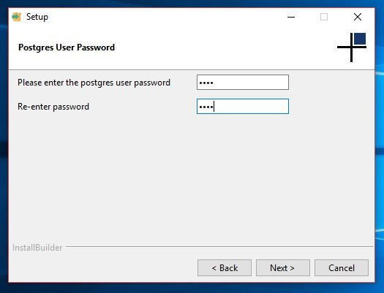
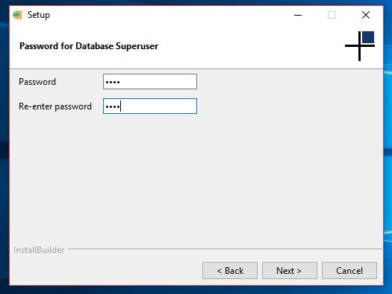
Installing PostgreSQL

Slide 14
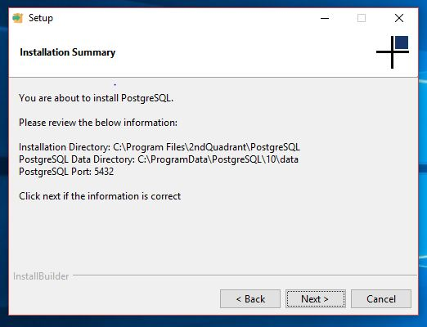
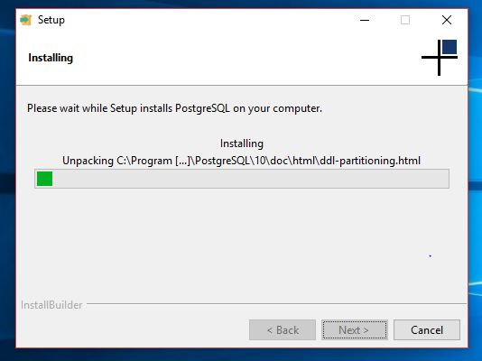
Installing PostgreSQL

Slide 15
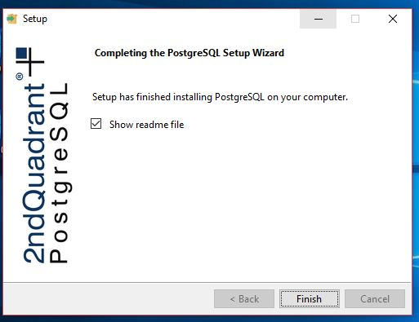
Installing PostgreSQL
Add PostgreSQL path to your system PATH C:\Program Files\PostgreSQL\{version}\bin

Slide 16
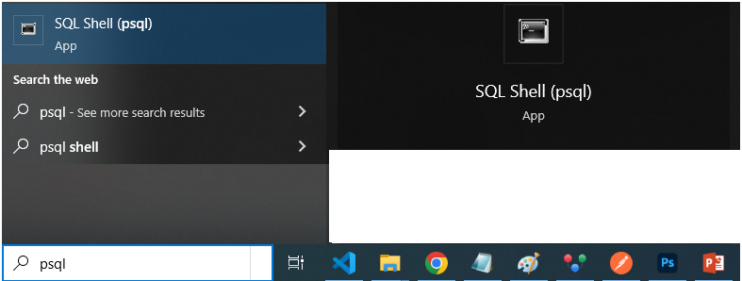
Accessing PostgreSQL

Slide 17
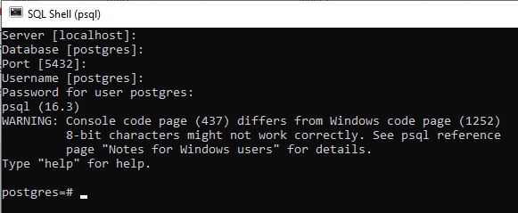
Connecting to PostgreSQL

Slide 18

What is a relational database?
A database that stores data in tables with relationships
Which of the following data types is supported by PostgreSQL?
JSON, XML, hstore
What does ACID stand for in the context of database transactions?
Atomicity, Consistency, Isolation, Durability
Why PostgreSQL is so popular in web development?
for its advanced features, ACID compliance, robust performance and scalability, active community support, and strong security capabilities

Slide 19

Task
Install PostgreSQL and make system ready for the connection

